Slide 1

Final Project SpaceCraft (on Three.js) Fast Forwards 2021
Tung Duong CS 460 Prof. Daniel Haehn

Slide 2
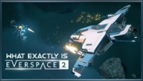
IDEA Creating a game (demo) similar with EVERSPACE 2 game

Slide 3

My Spacecraft game (demo)
https://tungduong2.github.io/cs460student/final/

Slide 4

Thank you!

